Slide 1

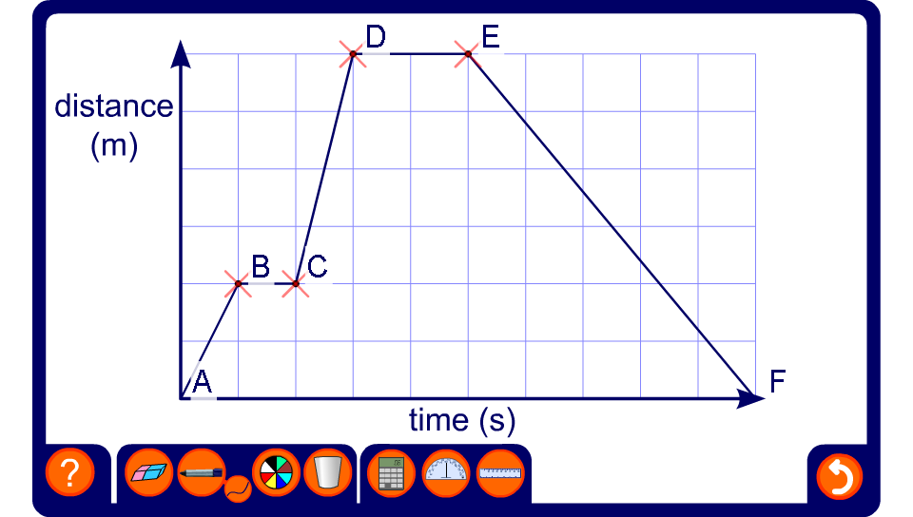


Interpreting distance-time graphs
Notes:
Move the points to change the graph and ask pupils to interpret it. For example, ask pupils at what speed the object is traveling for different stage in the journey.
Ask pupils to make up a story for a given graph.

